Slide 1
Final Project Predicting tree class based on tree leaf images
Yael Ezra

Slide 2
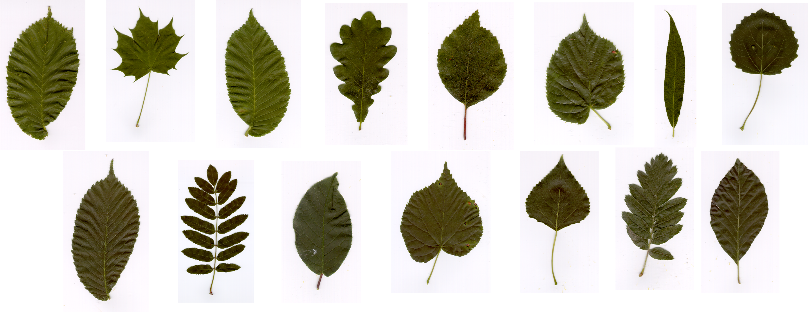
Swedish Leaf dataset

Slide 3
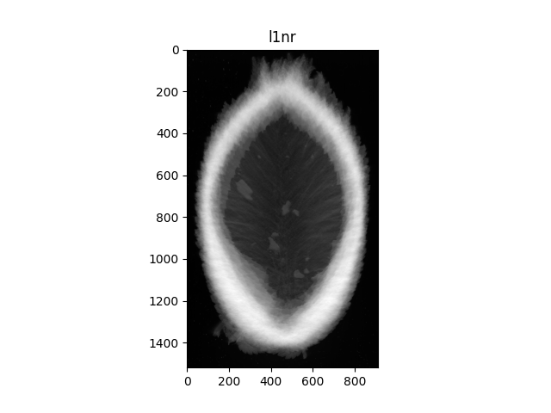
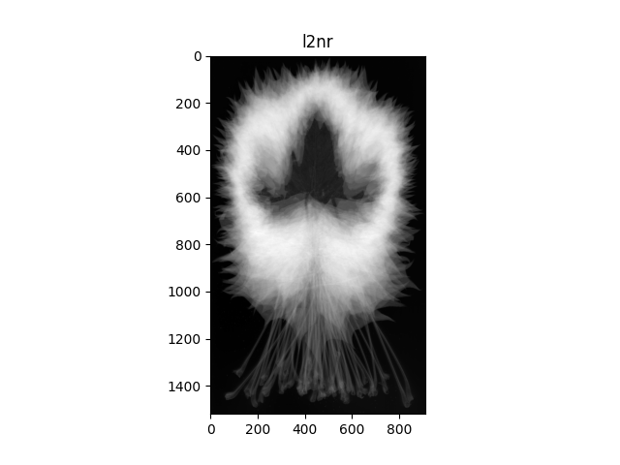
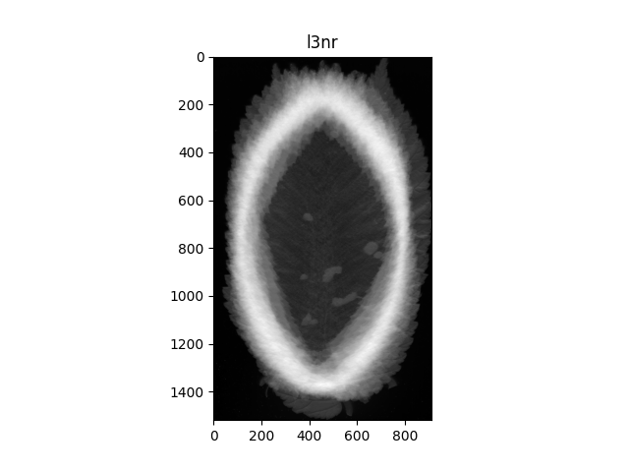
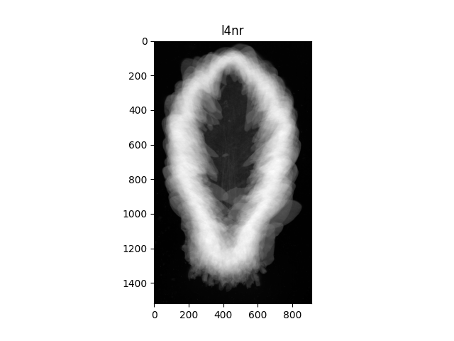
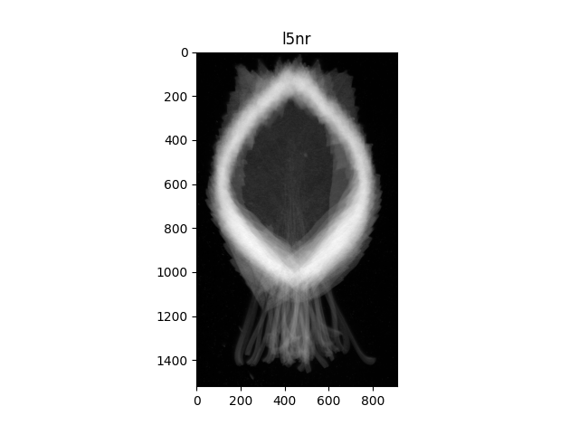
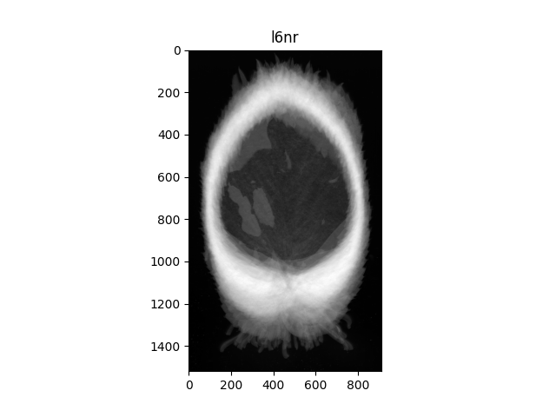
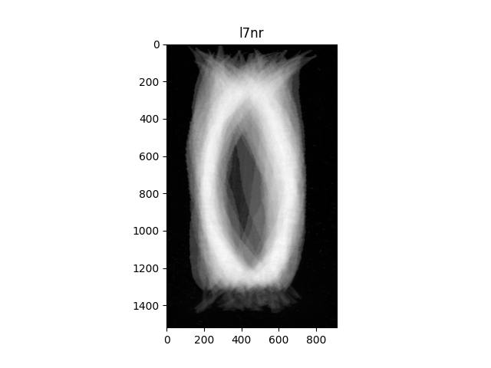
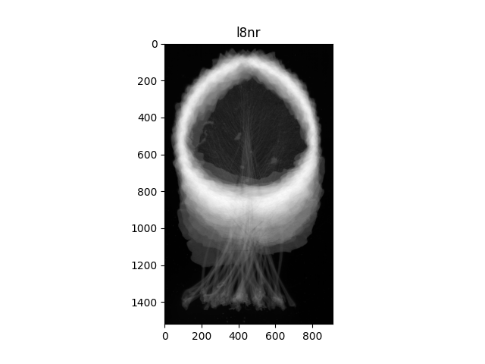
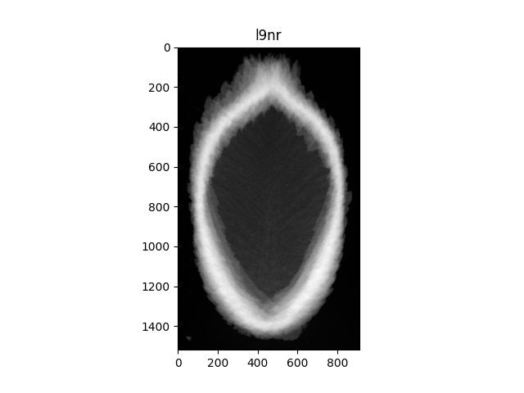
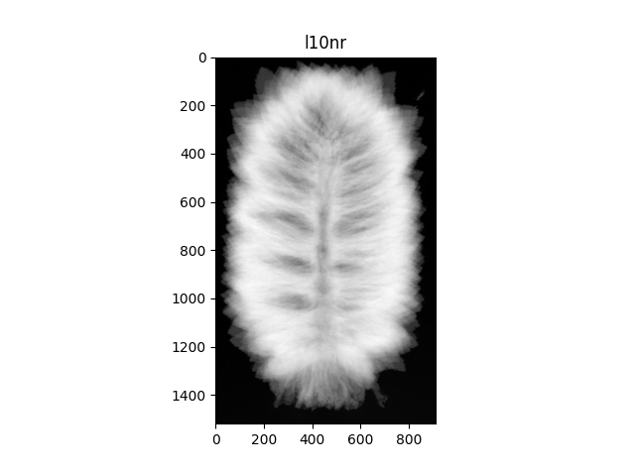
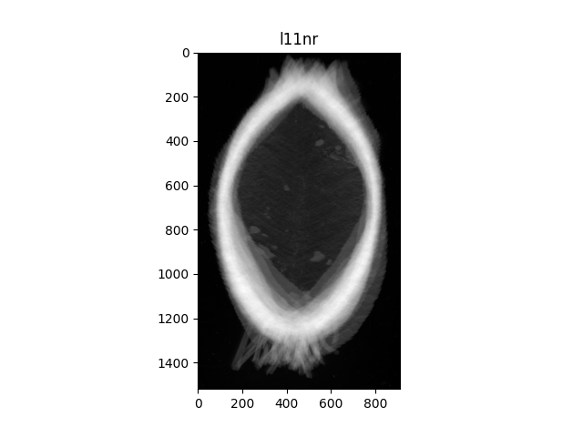
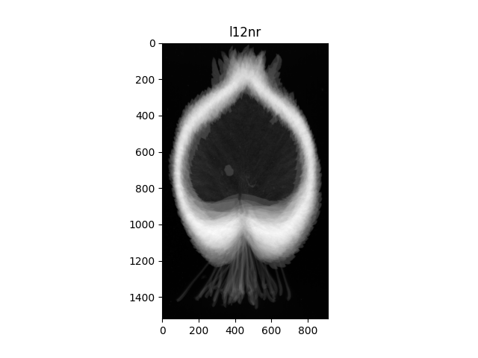
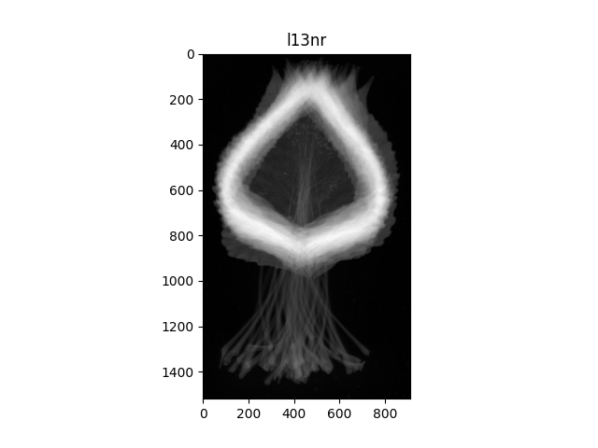
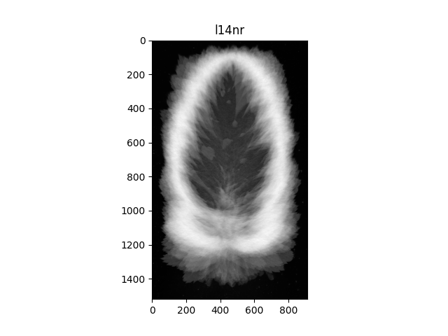
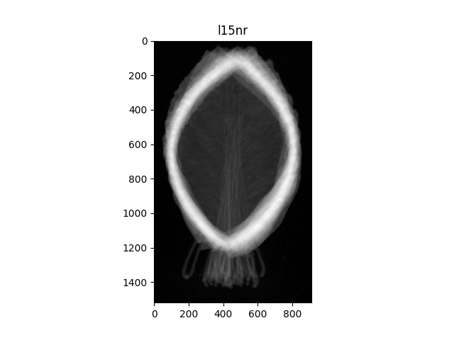
Intra Class Variability

Slide 4
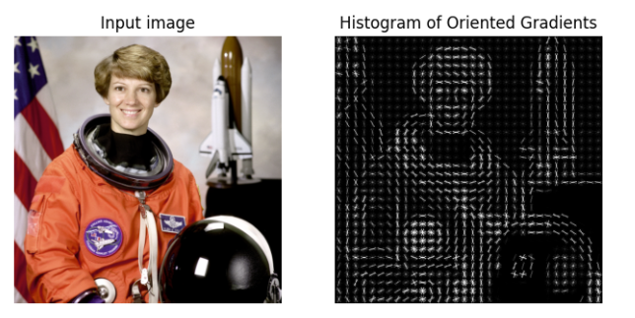
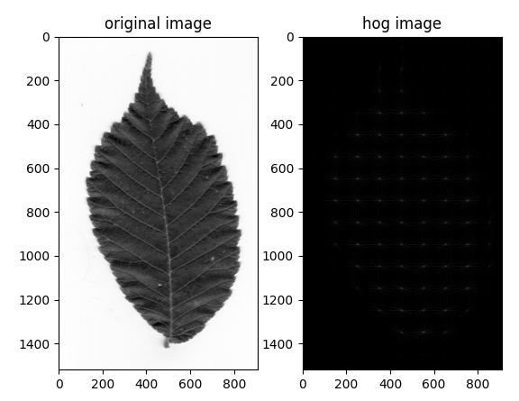
Feature Extraction
HOG – Histogram of Oriented Gradients
Resizing the images.
Each image is divided to blocks and each block is divided to cells.
The gradient of each pixel is calculated.
The magnitudes and angles of the gradients are calculated.
https://scikit-image.org/docs/dev/auto_examples/features_detection/plot_hog.html#sphx-glr-auto-examples-features-detection-plot-hog-py

Slide 5
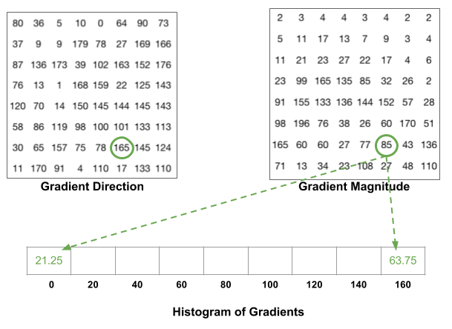
For each cell, a 9-point histogram is calculated.
https://medium.com/analytics-vidhya/a-gentle-introduction-into-the-histogram-of-oriented-gradients-fdee9ed8f2aa

Slide 6
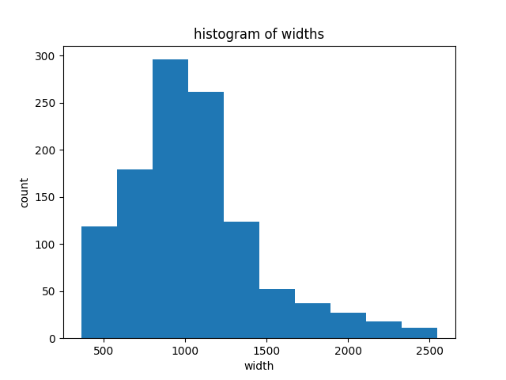
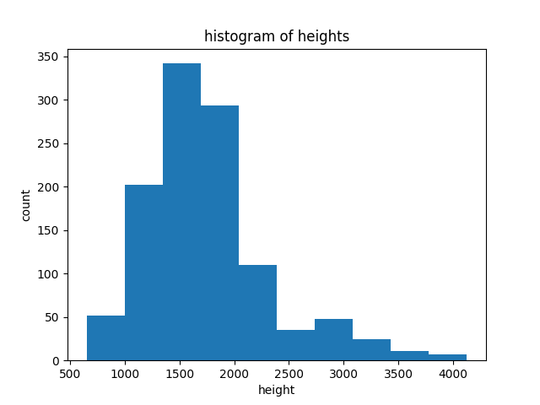
Resizing the Images

Slide 7
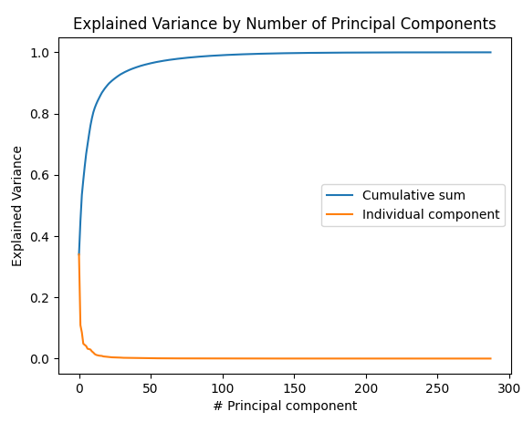
PCA for Dimension Reduction and EDA
Explained variance
1 | 0. 34
2 | 0.45
3 | 0.53
. . . | . . .
100 | 0.99

Slide 8
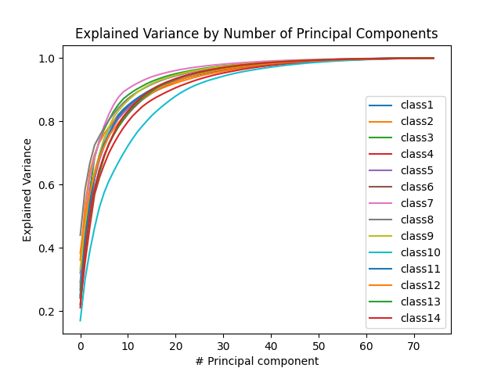
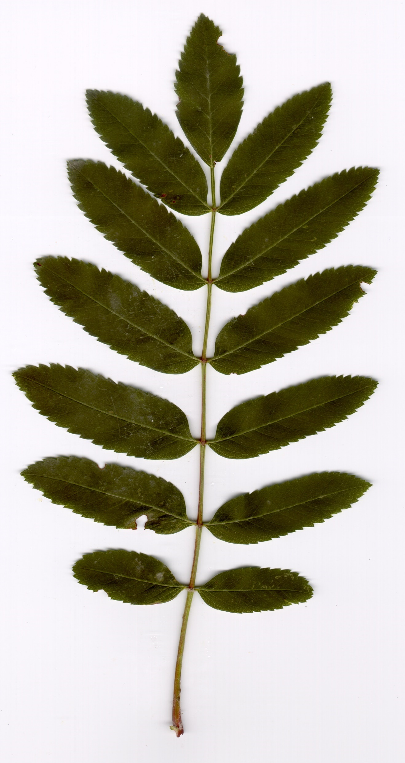
PCA for Each Class

Slide 9
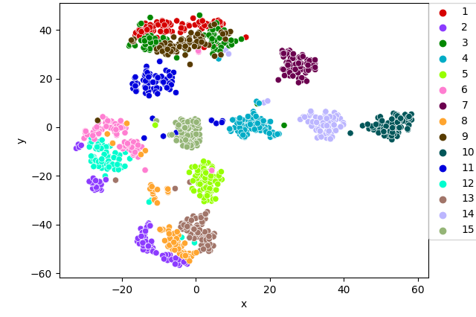
tSNE T-distributed Stochastic Neighbor Embedding

Slide 10
Models
MLPClassifier | Hidden layer size: (5,), (50,), (100,), (5, 5), (5, 100), (100, 100) Activation function: 'identity', 'logistic', 'tanh', 'relu’ Learning rate: 'constant', 'invscaling', 'adaptive’ Learning rate init: 0.001, 0.1, 10 Alpha: 0.0001, 0.05, 0.5
SVM | C: 0.05, 0.5, 1, 10, 100 Kernel: 'linear', 'poly', 'rbf', 'sigmoid'
Gradient Boosting Classifier | n estimators: 1, 10, 100 Max depth: 5, 10, 50, 100 Learning rate: 0.001, 0.1, 0.5, 0.7

Slide 11
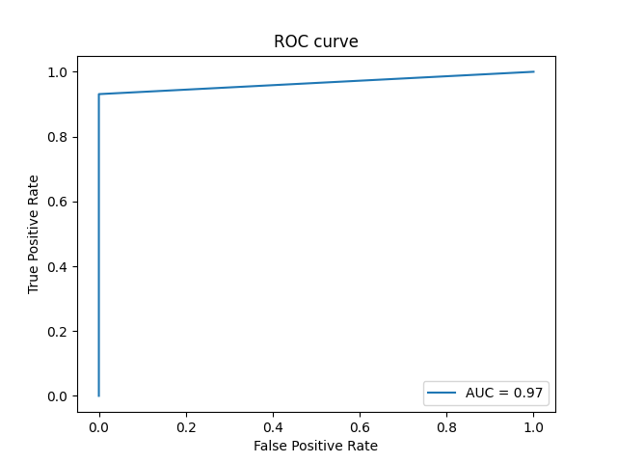
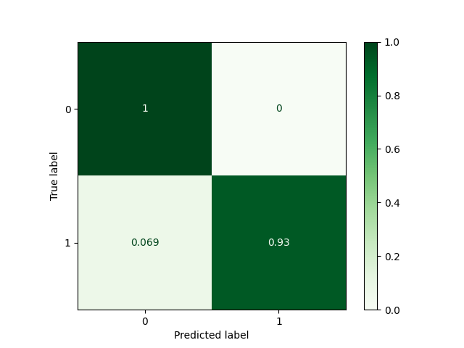
SVM
Best parameters: C: 0.05
Kernel: ‘linear’

Slide 12
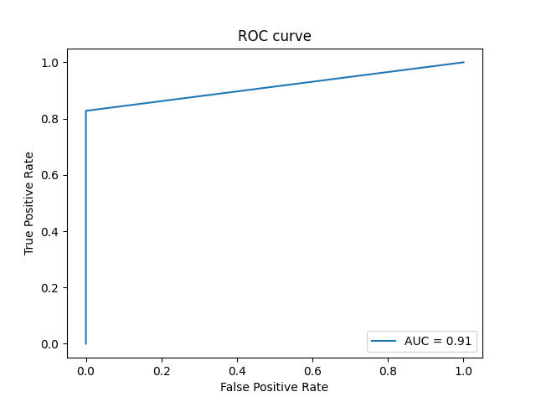
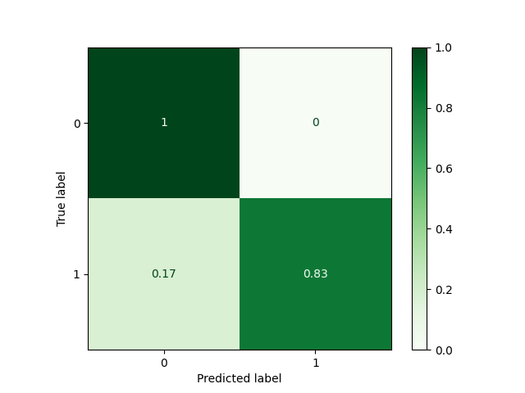
Gradient Boosting Classifier
Best parameters:
n estimators: 10
max depth: 5
learning rate: 0.1

Slide 13
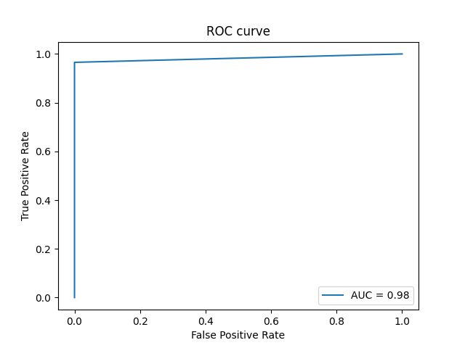
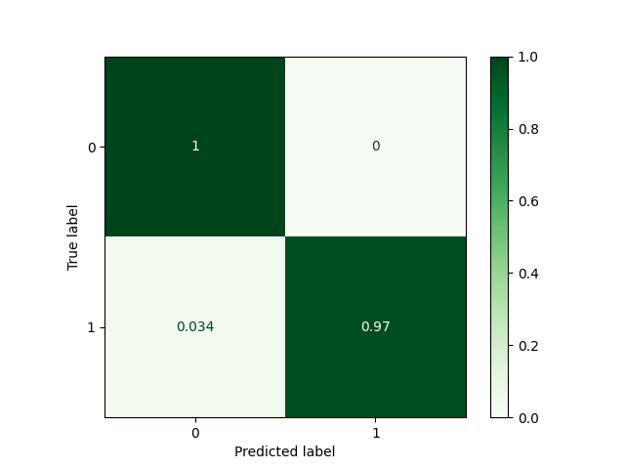
MLP Classifier
Best parameters:
hidden layer size: (50,)
activation function: ‘identity’
learning rate: ‘constant’
learning rate init: 0.001
alpha: 0.0001

Slide 14
Summary
In this project, I used the HOG method for extracting features and trained 3 models on the data.
MLPClassifier had the best performances.
A disadvantage of the one vs all method in this case is the imbalanced data.
A disadvantage of the HOG method is the number of features.

Slide 15
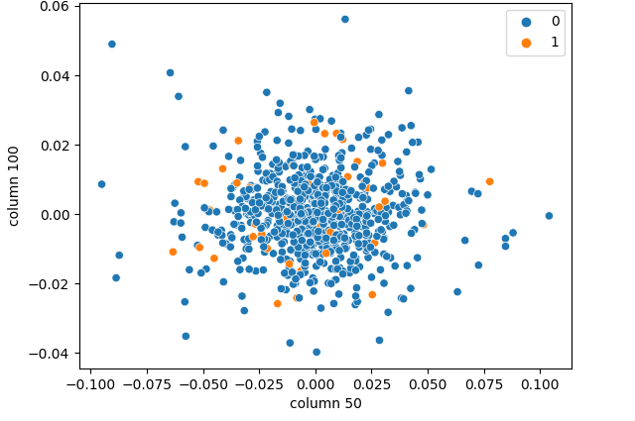
Imbalanced Data

